Slide 1
Demystifying CTI-110:
An Instructor’s Guide to User-Friendly APIs - with Integrated Network and Cyber Concepts
By: Nathan Mckee

Slide 2
About Me:
IT and Networking Instructor
James Sprunt Community College
As of Jan. 2024
Adjunct IT Instructor
Sampson Community College
Since Jan. 2016
*Teach Networking, Cybersecurity, Programming courses.

Slide 3
Rational For This Session :
Web, Programming, and DB Foundations (CTI-110) is often difficult for students
Lack of buy-in for IT students
Hard to relate content to the real world

Slide 4
Textbook Used:
A Web-Based Introduction to Programming
Essential Algorithms, Syntax, and Control Structures Using PHP, HTML, and MariaDB/MySQL, Fifth Edition
https://mikeokane.com/textbooks/wbip/
XAMPP – (www.apachefriends.org)

Slide 5
What is an API? :
API (Application Programming Interface)
a software intermediary that allows two applications to communicate with each other
RESTful Methods (how to interact)
POST – Create (resource)
GET - Read
PUT - Update
DELETE - Delete

Slide 6
Interesting APIs for students:
1) CVE Search 2) Website Scraper 3) Network Speed 4) Sqorz Timing 5) Twilio SMS and Email Sending 6) Weather Search 7) IP Data
JSON Notes:
Data is in name/value pairs
Data is separated by commas
Curly braces hold objects
Square brackets hold arrays

Slide 7
API #1: Common Vulnerabilities and Exposures (CVE)
Use: Get updated info on CVEs from NIST NVD site
NVD: https://nvd.nist.gov/
Alternate Link: https://www.cve.org/
Actual JSON link (notice query params): https://services.nvd.nist.gov/rest/json/cves/2.0/?pubStartDate=2021-08-04T00:00:00.000&pubEndDate=2021-08-04T12:00:00.000

Slide 8
API #2: Website Scraper
Use: Extract data from websites
RapidAPI: https://rapidapi.com/
Credentials Needed? Yes, no credit card
Actual JSON link (notice query params): https://site-scrapper.p.rapidapi.com/fetchsitetitle?url=https%3A%2F%2Fbooks.toscrape.com

Slide 9
API #3: Network Speed
Use: Test network speeds (to/from server)
SpeedOfMe: https://speedof.me/
Credentials Needed? Yes, no credit card
API Docs: https://speedof.me/api/doc/SpeedOfMe_API_Doc.pdf

Slide 10
API #4: Action Sports
Use: Track racer/runner data
Sqorz: https://our.sqorz.com
https://my.sqorz.com/training/transponder/KL-07919
Credentials Needed? No
API Docs(sample): https://our.sqorz.com/json/leaderboard/65bafa1317bdc8e05c381083

Slide 11
API #5: Messaging
Use: SMS and Email Sending
Twilio: https://www.twilio.com/en-us
Credentials Needed? Yes, no credit card needed
API Docs: https://www.twilio.com/docs/usage

Slide 12
API #6: Weather Data
Use: Get weather, temp, hum, radiation, etc.
Open Weather Map: https://openweathermap.org/
Credentials Needed? No
Actual JSON link (notice query params): https://api.openweathermap.org/data/2.5/weather?lat=$lat&lon=$lon&appid=0ea9892eb5854574ce5ef33a7787c6aa&units=imperial

Slide 13
API #7: IP Data
Use: Get country, region, city, zip, lat, long, timezone, isp, etc.
IP-Api: https://ip-api.com/
Credentials Needed? No
Actual JSON link (notice query params):
https://ip-api.com/#www.isothermal.edu
http://ip-api.com/json/204.84.224.5 (or isothermal.edu)

Slide 14

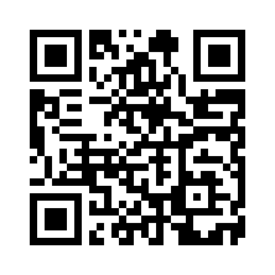
Thank You!
https://rapidapi.com/vishwaraj/api/hashing-api3
https://www.hybrid-analysis.com/docs/api/v2#/Search/0197a6ff29eab44bf4d18d45bb67aedb
https://developers.google.com/maps
nmckee@jamessprunt.edu

